Slide 1
Rule-Based Systems Session 11
Course : COMP6228 – Artificial Intelligence
Effective Period : February 2018

Slide 2
Learning Objective
After completing this session, students are expected to be able to:
LO 2 : Explain concepts of AI Techniques in Games

Slide 3
Content
Rule-Based Systems
Rule Arbitration
Unification
Rete
Extensions

Slide 4
Rule-Based Systems
Rule-based systems were at the vanguard of AI research through the 1970s and early 1980s.
Many of the most famous AI programs were built with them, and in their “expert system” incarnation, they are the best known AI technique.
Rule-based systems have a common structure consisting of two parts: a database containing knowledge available to the AI and a set of if–then rules.
Rules can examine the database to determine if their “if” condition is met. Rules that have their conditions met are said to trigger. A triggered rule may be selected to fire, whereupon its “then” component is executed.

Slide 5
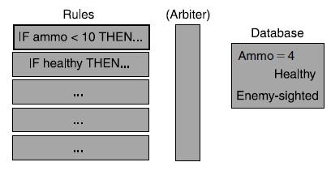
Rule-Based Systems
Schematic of a rule-based system

Slide 6
Rule-Based Systems
Database Matching
The “if” condition of the rule is matched against the database; a successful match triggers the rule. The condition, normally called a pattern, typically consists of facts identical to those in the database, combined with Boolean operators such as AND, OR, and NOT.
Suppose we have a database containing information about the health of the soldiers in a fire team, for example. At one point in time the database contains the following information:
Captain’s health is 51
Johnson’s health is 38
Sale’s health is 42
Whisker’s health is 15

Slide 7
Rule-Based Systems
Database Matching
The “if” condition of the rule is matched against the database; a successful match triggers the rule. The condition, normally called a pattern, typically consists of facts identical to those in the database, combined with Boolean operators such as AND, OR, and NOT.
Suppose we have a database containing information about the health of the soldiers in a fire team, for example. At one point in time the database contains the following information:
Captain’s health is 51
Johnson’s health is 38
Sale’s health is 42
Whisker’s health is 15

Slide 8
Rule-Based Systems
Whisker, the communications specialist, needs to be relieved of her radio when her health drops to zero. We might use a rule that triggers when it sees a pattern such as:
Whisker: health = 0
Of course, the rule should only trigger if Whisker still has the radio. So, first we need to add the appropriate information to the database. The database now contains the following information:
Captain’s health is 51
Johnson’s health is 38
Sale’s health is 42
Whisker’s health is 15
Radio is held by Whisker
Now our rule can use a Boolean operator. The pattern becomes:
Whisker’s health is 0 AND Radio is held by Whisker

Slide 9
Rule-Based Systems
In practice we’d want more flexibility with the patterns that we can match. In our example, we want to relieve Whisker if she is very hurt, not just if she’s dead. So the pattern should match a range:
Whisker’s health < 15 AND Radio is held byWhisker
So far we’re on familiar ground. It is similar to the kind of tests we made for triggering a state transition or for making a decision in a decision tree.

Slide 10
Rule-Based Systems
To improve the flexibility of the system, it would be useful to add wild cards to the matching. We would like to be able to say, for example,
Anyone’s health < 15
and have this match if there was anyone in the database with health less than 15. Similarly, we could say,
Anyone’s health < 15 AND Anyone’s health > 45
to make sure there was also someone who is healthy (maybe we want the healthy person to carry the weak one, for example).

Slide 11
Rule Arbitration
Several rules may trigger on the database at the same time. Each rule is applicable, but only one can fire. In the algorithm described above we assumed that the first triggered rule is allowed to fire and no other rules are considered. This is a simple rule arbitration algorithm: “first applicable.” It works fine as long as our rules are arranged in order of priority.
There are a number of common approaches to arbitration, each with its own characteristics.
First Applicable
Least Recently Used
Random Rule
Most Specific Conditions
Dynamic Priority Arbitration

Slide 12
Unification
Suppose in our earlier example Whisker, the communications specialist, ended up dying.
Her colleague Sale takes over carrying the radio. Now suppose that Sale is severely hurt; somebody else needs to take the radio.
We could simply have a rule for each person that matches when they are hurt and carrying the radio.

Slide 13
Rete
The Rete algorithm is an AI industry standard for matching rules against a database. It is not the fastest algorithm around; there are several papers detailing faster approaches. But, because expert systems are commercially valuable, they don’t tend to give full implementation details.
Most commercial expert systems are based on Rete, and some of the more complex rule-based systems we’ve seen in games use the Rete matching algorithm. It is a relatively simple algorithm that provides the basic starting point for more complex optimizations.

Slide 14
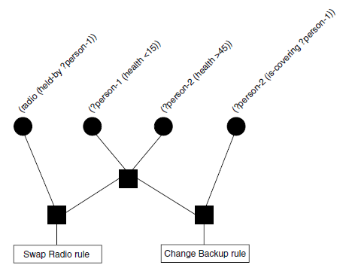
Rete
The algorithm works by representing the patterns for all rules in a single data structure: the Rete.
The Rete is a directed acyclic graph

Slide 15
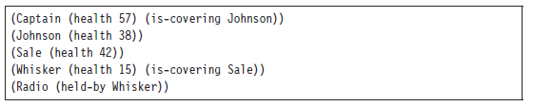
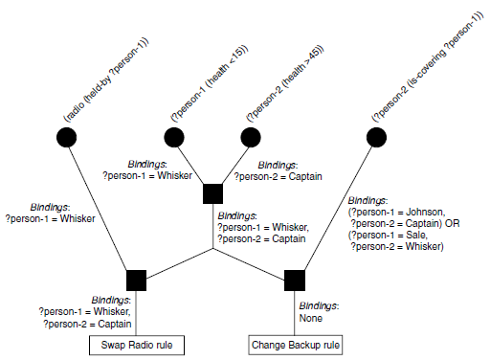
Rete
Let’s apply our initial Rete example to the following database:
Figure below shows the network with the data stored at each node

Slide 16
Extensions
The ubiquity of rule-based systems in early AI research led to a whole host of different extensions, modifications, and optimizations. Each area in which a rule-based system was applied (such as language understanding, controlling industrial processes, diagnosing faults in machinery, and many others) has its own set of common tricks.
There are two extensions that are widespread enough to be worth mentioning. The first manages huge rule-based systems and is of direct use to games developers. The second is justification, widely used in expert systems and useful to game developers when debugging their AI code.

Slide 17
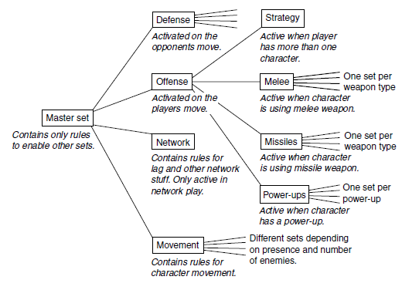
Extensions
Schematic of the rule sets in the game

Slide 18
References
Ian Millington. 2009. Artificial intelligence for games. Morgan Kaufmann Publishers. Burlington. ISBN:9780123747310
Decision Making, https://www.cs.umd.edu/class/spring2013/cmsc425/Lects/lect20.pdf

